Slide 1

Pharma and Counterfeit Drug Prevention Supply Chain and Smart Contracts System in Blockchain
Savitribai Phule University Affiliated Matoshri College of Engineering and Research Centre
Nashik
Department of Computer Engineering 2024– 2025
Members Details:
1. Nitin Aher
2. Tanmay Mahale
3. Sopan Patil
4. Ajay Jadhav
Guide Name:Dr V H Patil

Slide 2
Contents
Introduction
Literature Survey
Motivation
Problem statement
Objectives
System architecture
Modules of the project
Algorithm Details
Design of the system
Implementation details of the first module
Conclusion
Reference

Slide 3
Introduction
The pharmaceutical industry faces significant challenges with counterfeit drugs, which pose serious risks to patient safety and public health. To combat this issue, the integration of blockchain technology offers a promising solution by enhancing transparency and traceability in the supply chain.
This project aims to develop a robust system that utilizes smart contracts within a healthcare blockchain framework to ensure the authenticity of drugs. By securely tracking the entire lifecycle of pharmaceutical products—from production to distribution—we can effectively prevent counterfeit drugs from entering the market.
This system not only safeguards patient health but also fosters trust in the pharmaceutical supply chain, benefiting stakeholders across the industry.

Slide 4
Literature survey
Sr. No. | Authors | Algorithm | Advantage | Limitation
01 | Gupta A, Patel J, Gupta M, Gupta H. | Map Reduce | The technology is more scalable, tamper proof and time stamped, making health data more secure. | Large amount of Dataset Required.
02 | Ariel Ekblaw, Asaph Azaria, John D. Halamka, Andrew Lippman | Map Reduce | This system gives patients a comprehensive, immutable log and easy access to their medical information across providers and treatment sites. | face a critical need for Electronic Health Records (EHRs).
03 | Jie Zhang Nian Xue and Xin Huang | Association Protocol | Propose a secure system for PSN-based healthcare. | Problem with a PSN node can securely share health data with other nodes in the network
04 | Saad Khan, Simon Parkinson and Yongrui Qin | Advanced Encryption Standard | Fog systems are capable of processing large amounts of data locally, operate on-premise, are fully portable | Consuming limited amount of resources.

Slide 5
Literature survey
Sr. No. | Authors | Algorithm | Advantage | Limitation
05 | Crosby, M., Pattanayak, P., Verma, S., & Kalyanaraman, V. | Proof of Work (PoW) | Ensures data immutability and decentralized trust. | High energy consumption and scalability challenges.
06 | Christidis, K., & Devetsikiotis, M. | Smart Contracts and Blockchain integration for IoT. | Enables autonomous, secure transactions among IoT devices. | Limited processing power and storage in IoT devices restrict adoption.
07 | Kshetri, N. | Traceability and audit mechanisms in supply chains. | Improves transparency and prevents counterfeit products. | Integration with legacy systems is complex and costly.
08 | Zheng, Z., Xie, S., Dai, H. N., Chen, X., & Wang, H. | Multiple consensus algorithms like PoW, PoS, and PBFT. | Provides comprehensive insight into blockchain's scalability and security. | Lacks focus on real-time deployment and energy efficiency in diverse applications.

Slide 6
Motivation
The rising prevalence of counterfeit drugs is a critical issue that endangers lives and undermines trust in healthcare systems. Motivated by the need to protect patients and ensure the integrity of pharmaceutical products, this project seeks to leverage blockchain technology as a powerful tool for transparency and security.
By implementing a supply chain system with smart contracts, we can create an unalterable record of drug transactions, making it nearly impossible for counterfeit products to infiltrate the market.
This initiative aims to enhance patient safety, strengthen regulatory compliance, and ultimately contribute to a more trustworthy healthcare ecosystem.

Slide 7
Problem Statement
Counterfeit drugs threaten patient safety and trust in healthcare. Our project uses blockchain and smart contracts to create a transparent, secure system for tracking pharmaceuticals, ensuring authenticity from manufacturer to consumer.

Slide 8
OBJECTIVES OF WORK
To develop a custom Blockchain solution tailored for the healthcare pharmaceutical supply chain to ensure real-time tracking and verification of drugs.
To integrate Smart Contracts into the custom Blockchain system to automate compliance with healthcare regulations and reduce manual processing errors.
To enhance supply chain transparency and accountability by using an immutable Blockchain ledger to record every transaction involving pharmaceutical products.
To implement advanced counterfeit detection mechanisms within the Blockchain framework to prevent the introduction of fake drugs into the healthcare system.
To enable secure and timely access to accurate drug information for all stakeholders, thereby improving trust and operational efficiency in the pharmaceutical supply chain.

Slide 9
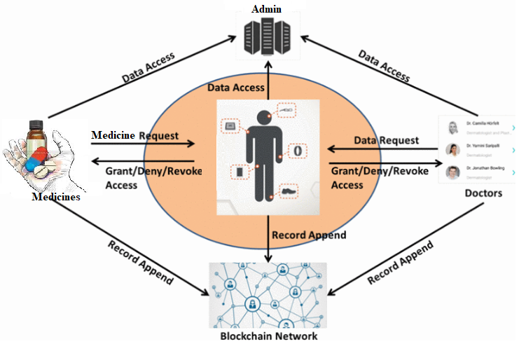
Proposed System Architecture

Slide 10
Mathematical Model
All (n) data nodes will return 1 when each have the same blockchain,
Q = initial transactional data with genesis block
∑ = {SHA-256, Consensus_Val, Mining}
Δ = Validate all server(S1 ⊆ S2⊆ S3⊆ S4) all server validation process
q0 = Initial transaction T[0]
F = {Commit Trans, GetHostoryRecord}
State =>1: if all chains are validating or same
0: if any t(n) server consist the invalid chain

Slide 11
Mathematical Model (Cont..)
Set dependency
Sys= {Phash, Tdata, Chash}
Get blockchain from each node and validate with each other.

Slide 12
Modules of the project
User Authentication Module
Smart Contracts Module
Patient Module
Hospital Module
Admin Module
Supplier Module
Pharmacy Module
Dealer Module
Wholesaler Module

Slide 13
User Authentication Module : Enables secure registration and authentication for all stakeholders, including, Patients, Hospitals, Distributors, and Admin regulators.
Input: User credentials (username, password, etc.)
Processing: Hashing Algorithm (SHA-256) To Hash and Securely Store Passwords, Compare With Stored Hashes For Login Verification.
Output: Authentication success (user granted access) or failure (access denied).

Slide 14
Smart Contracts Module : Implements automated agreements that enforce rules and conditions for transactions, ensuring that only verified products move through the supply chain.
Input: Transaction Details (Drug Verification, Shipment Conditions).
Processing: Smart Contract Execution Algorithm That Automatically Enforces Conditions Written In Smart Contracts.
Output: Automatic Approval Or Rejection Of Transactions Based On Contract Rules.

Slide 15
Patient Module : Allows patients to create and manage profiles, ensuring secure access to their health records and medication history, Insurance details, and pharma supply chain records.
Input: Patient’s Profile, Health Records, Prescriptions.
Processing: Blockchain Query Algorithm To Retrieve Patient Data Securely From The Blockchain Using Unique Ids.
Output: Verified Access To Patient Health Records.

Slide 16
Hospital Module : Helps hospitals track and manage their pharmaceutical inventory, ensuring they have access to authentic medications and preventing stockouts.
Input: Inventory Details, Stock Levels, Procurement Requests.
Processing: Blockchain Query Algorithm to Verify Drug Authenticity and Track Inventory Updates in Real-time.
Output: Updated Inventory Status with Alerts for Low Stock or Counterfeit Drugs.

Slide 17
Admin Module
Manages And Monitors The Entire Drug Supply Chain, Ensuring Everything Runs Smoothly And Securely.
Input: User Details, System Settings, And Compliance Reports.
Processing: Controls User Access, Oversees Security, And Checks Compliance With Rules.
Output: Logs Of User Activities, System Performance Reports, And Alerts For Any Issues.

Slide 18
Pharmacy Module
Manages Drug Sales And Verifies Product Authenticity Before Dispensing To Customers.
Input: Customer Drug Requests And Drug Authentication Details.
Processing: Verifies Drug Batch Via Blockchain And Confirms Validity.
Output: Dispenses Genuine Drug And Logs Transaction To Blockchain.

Slide 19
Supplier Module
Supplies medicines to dealers or wholesalers and updates product batches..
Input: Drug production data and supply request.
Processing: Encrypts and stores batch data in blockchain using smart contracts.
Output: Immutable batch entry with supply status update.

Slide 20
Dealer Module
Acts as an intermediary, confirming the integrity of drugs received.
Input: Supply batch details from supplier.
Processing: Cross-checks batch history and approves transfer via smart contract.
Output: Acknowledgement of receipt and verification log.

Slide 21
Wholesaler Module
Handles bulk drug distribution and tracks shipment authenticity.
Input: Drug orders from pharmacies and verified batch info.
Processing: Matches order with verified stock and records dispatch.
Output: Shipment record with traceable blockchain transaction.

Slide 22
ALGORITHM
Algorithm 1: Hash Generation
Algorithm 2: Protocol For Peer Verification
Algorithm 3: Mining Algorithm For Valid Hash Creation
Algorithm 4: SHA-256

Slide 23
Hash Generation:
A Hash Algorithm Is A Function That Converts A Data String Into A Numeric String Output Of Fixed Length. The Output String Is Generally Much Smaller Than The Original Data. ... Two Of The Most Common Hash Algorithms Are The Md5 (Message-digest Algorithm 5) And The Sha-1 (Secure Hash Algorithm).
Hashing Is Used To Index And Retrieve Items In A Database Because It Is Faster To Find The Item Using The Shorter Hashed Key Than To Find It Using The Original Value. It Is Also Used In Many Encryption Algorithms.

Slide 24
Sha-256
With The Birth Of Bitcoin, SHA-256 Became The First Mining Algorithm Used In Technology Blockchain. This Is A Powerful Hash Function. It Serves Multiple Purposes Within Bitcoin And Virtually All Existing Cryptocurrencies. From Ensuring The

Slide 25
Protocol For Peer Verification:
All Peers On A Blockchain Network Reach A Consensus To Verify Transactions. This Consensus Is Governed By An Algorithm Fed Into The Protocol Layer Of The Blockchain. The Blockchain Gives All Peers An Identical Copy Of Each Transaction Which Eliminates Trust Thus Making A Trustless, Distributed Network.

Slide 26
Mining Algorithm For Valid Hash Creation:
Mining Algorithms Are The Algorithms Or Functions That Make The Task Of Mining Crypto-currencies Possible.
Mining Algorithms Are The Algorithms In Charge Of Making Possible The Cryptocurrency Mining. Normally These Algorithms Are Cryptographic Hash Functions Very Complex And They Can Adjust The Mining Difficulty. A Process That Makes It More Or Less Difficult For You To Put Together The Puzzles That Must Be Solved By The Miners. This Is To Get Miners To Do Complex Computational Work That, Once Solved, Allows Them To Access A Reward For That Work.

Slide 27
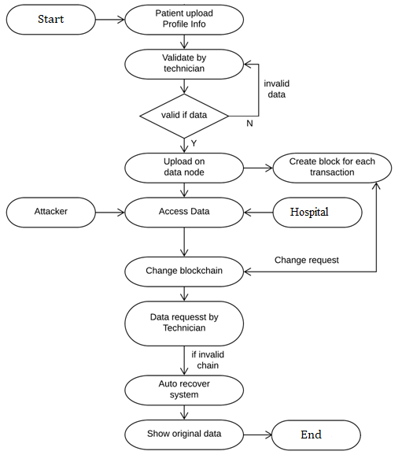
Design of the system
State Transition Diagram:

Slide 28
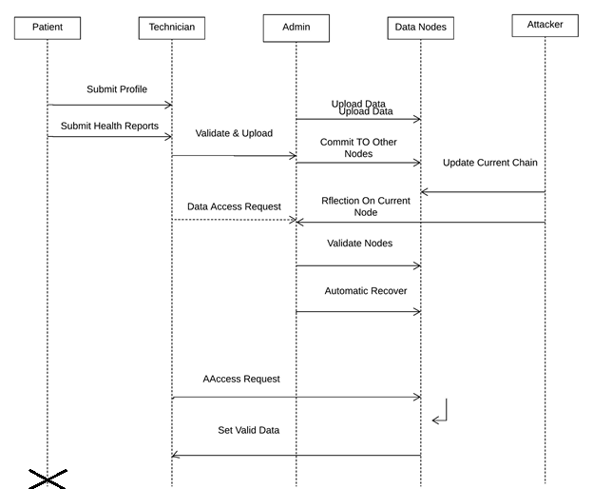
Design of the system
Sequence Diagram:

Slide 29
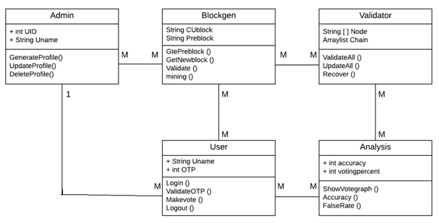
Design of the system
Class Diagram:

Slide 30
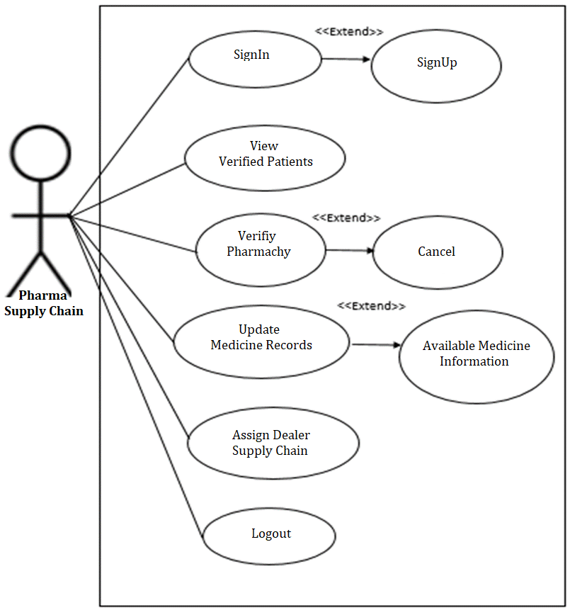
Design of the system
Use Case Diagram:

Slide 31
Conclusion
In conclusion, the implementation of a Pharma and Counterfeit Drug Prevention Supply Chain and Smart Contracts System using blockchain technology offers a powerful solution to combat the growing threat of counterfeit drugs.
By ensuring transparency, security, and traceability throughout the pharmaceutical supply chain, this system not only protects patient safety but also fosters trust among stakeholders.
The use of smart contracts automates and enforces compliance, further enhancing the reliability of drug distribution.
Ultimately, this project aims to create a safer healthcare environment, reducing the risks associated with counterfeit medications and improving overall public health outcomes.

Slide 32
References
[1] Crosby, M., Pattanayak, P., Verma, S., & Kalyanaraman, V. (2016). Blockchain technology: Beyond bitcoin. Applied Innovation Review, 2(6), 71-77.
[2] Christidis, K., & Devetsikiotis, M. (2016). Blockchains and smart contracts for the internet of things. IEEE Access, 4, 2292-2303.
[3] Kshetri, N. (2018). 1 Blockchain's roles in meeting key supply chain management objectives. International Journal of Information Management, 39, 80-89.
[4] Zheng, Z., Xie, S., Dai, H. N., Chen, X., & Wang, H. (2018). An overview of blockchain technology: Architecture, consensus, and future trends. IEEE Transactions on Emerging Topics in Computing, 7(1), 1-16.
[5] Peters, G. W., & Panayi, E. (2016). Understanding modern banking ledgers through blockchain technologies: Future of transaction processing and smart contracts on the internet of money. Banking and Financial Technologies, 2(3), 1-10.
[6] Mackey, T. K., & Nayyar, G. (2016). Digital counterfeiting: The role of the internet in counterfeit drug supply. Journal of Pharmaceutical Policy and Practice, 9(1), 6.

Slide 33
References
[7] Wang, Y., Han, J., & Bao, H. (2019). Blockchain-based solutions for the pharmaceutical supply chain: A review. Journal of Healthcare Engineering, 2019, 1-11.
[8] Bauwens, L., & Bruynseels, K. (2020). Blockchain for pharmaceuticals: A review of the literature. Journal of Business Research, 114, 311-319.
[9] Armer, J. M., & Catterall, S. (2019). Applying blockchain technology to healthcare and pharmaceutical supply chains. Health Information Science and Systems, 7(1), 12.
[10] Gordon, W. J., & Catalini, C. (2018). Blockchain technology for healthcare: A systematic review. Journal of Biomedical Informatics, 86, 27-35.
[11] Deloitte. (2020). The future of blockchain in healthcare: Enhancing transparency and efficiency in the supply chain. Deloitte Insights.
[12] Zheng, Z., Zheng, Y., & Wu, J. (2020). A survey on blockchain for healthcare: Applications, opportunities, and threats. IEEE Access, 8, 111571-111588.

Slide 34


